Slide 1

BLUE TEAM
Pham ai nhan
Nguyen ngoc thanh
Quach ngoc son
Ho do minh quang
Ly viet khang

Slide 2

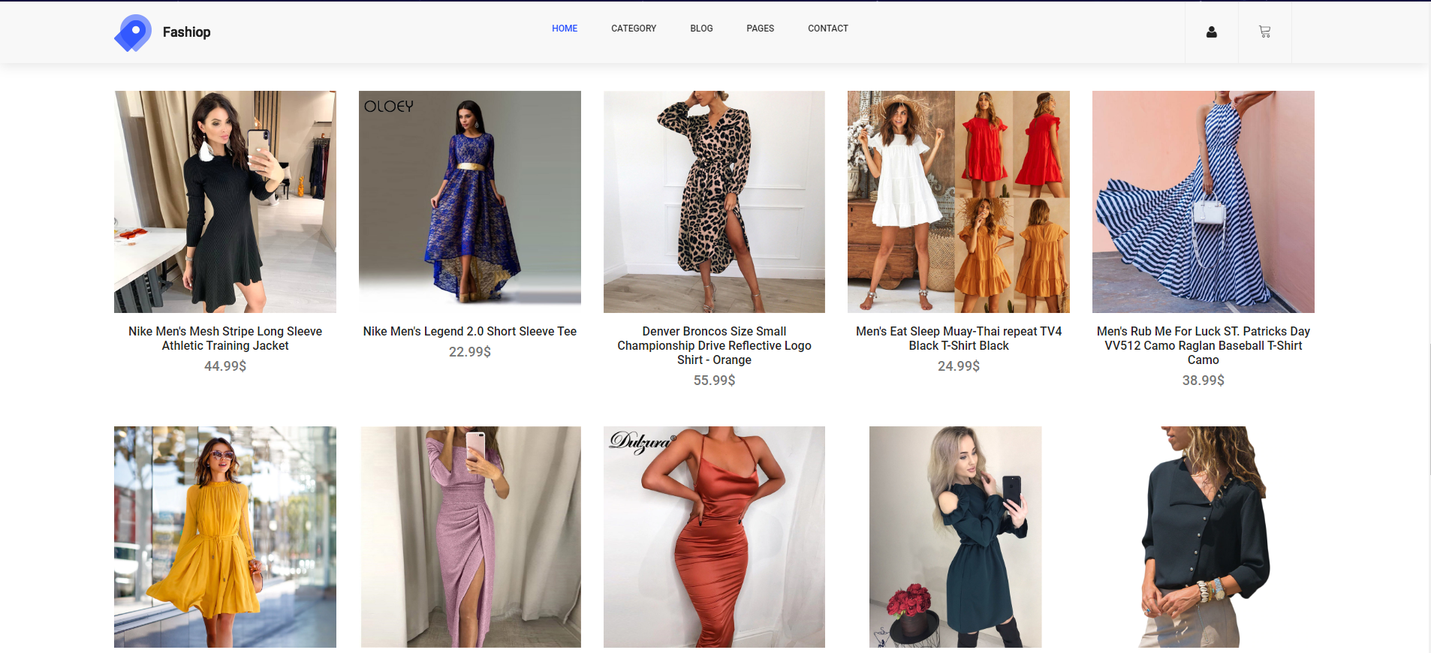
What do we do?
Ecommerce Website

Slide 3


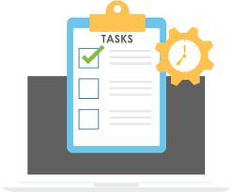
Why do we do this website?
Task from Mr. Green Bean (Mr. Mario)

Slide 4

Why do we do this website?
Increase technical skills – soft skills of all member in blue team

Slide 5


Why do we do this website?
One member in blue team needs a website to sell his product.

Slide 6





When do we do this?
13 – 18/8/2019: Setup environments

Slide 7

When do we do this?
19 – 21/8/2019: Project Planning
Task for each member in team

Slide 8


When do we do this?
22/8 – 15/9/2019: Coding
Configure Database.
Each member in team does personal task.

Slide 9


Front-end & back-end

Slide 10
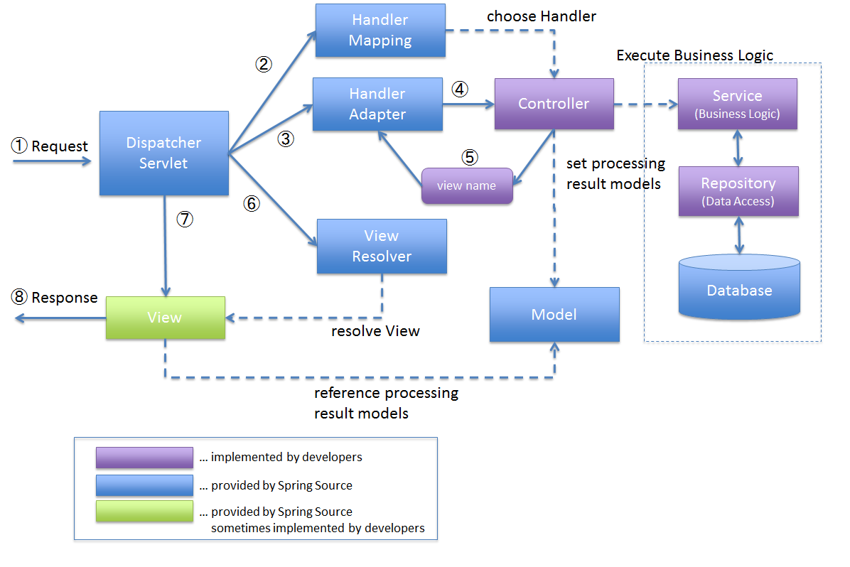
Spring MVC Architecture

Slide 11
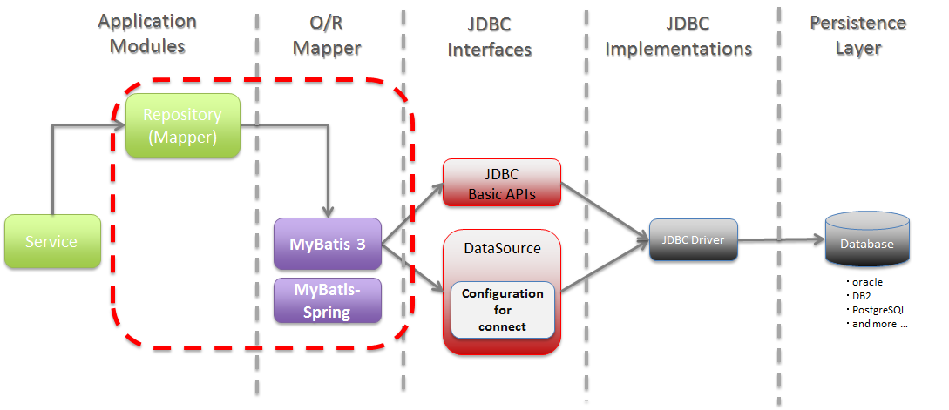
Mybatis architecture

Slide 12
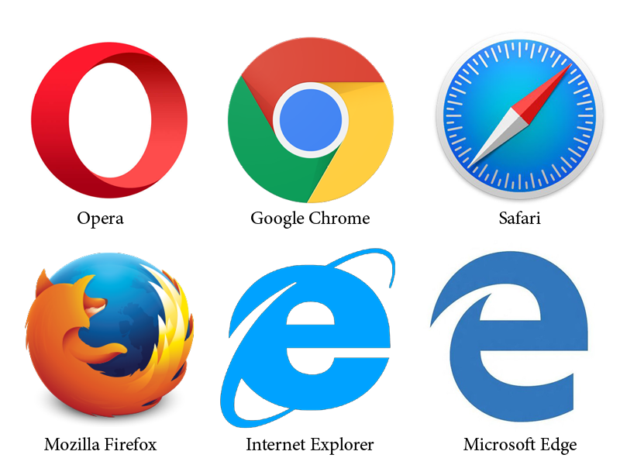
Project Spring mvc architecture
Interceptor
Controller
Controller Layer
Service
ServiceImpl
Service Layer
DAO
DAOImpl
Data Access Layer

Slide 13




SERVER CONFIGURATION
User
Tomcat
Database
http//:192.168.123.79:3306
http//:localhost/
Admin
http//:192.168.123.74:8080
Database
Apache 2
User
http//:192.168.123.109:8080
http//:192.168.123.90

Slide 14
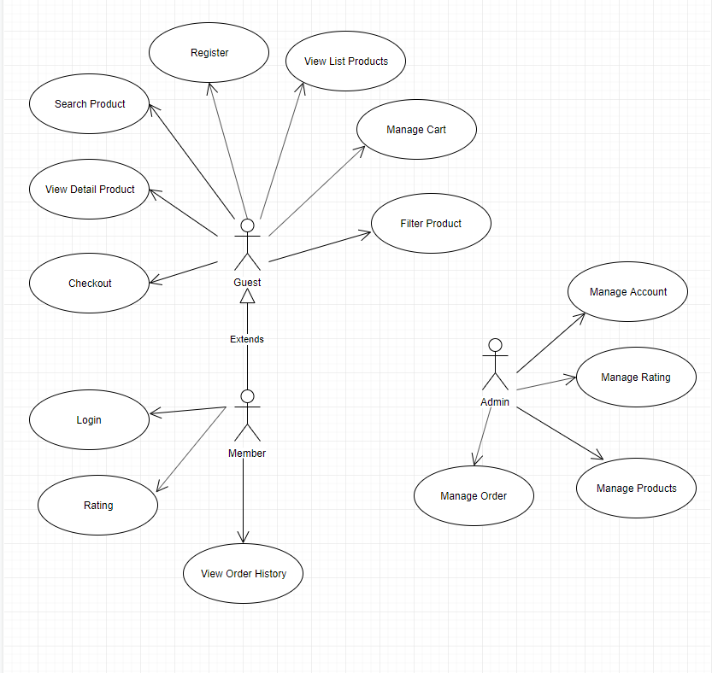
Use-case

Slide 15
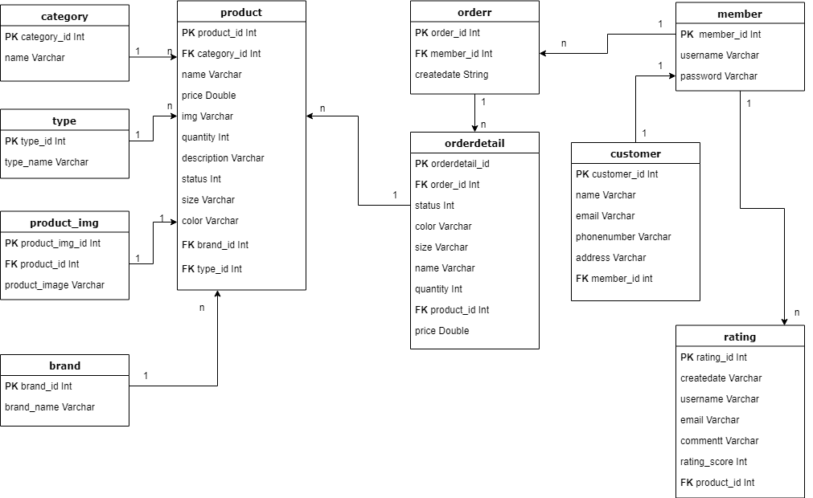
Clothes Database diagram

Slide 16
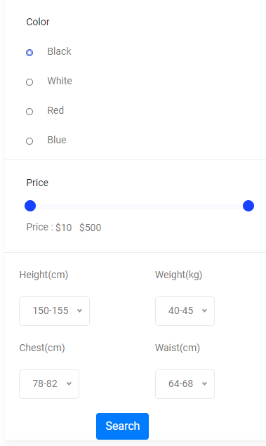
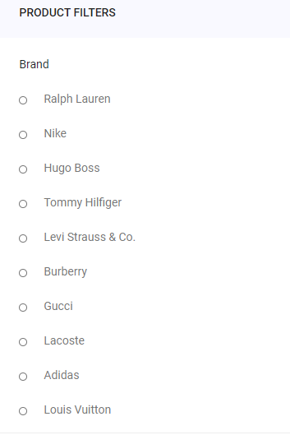
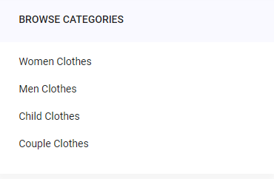

How do we do this?
Nhan Pham
Load list product
Filter

Slide 17
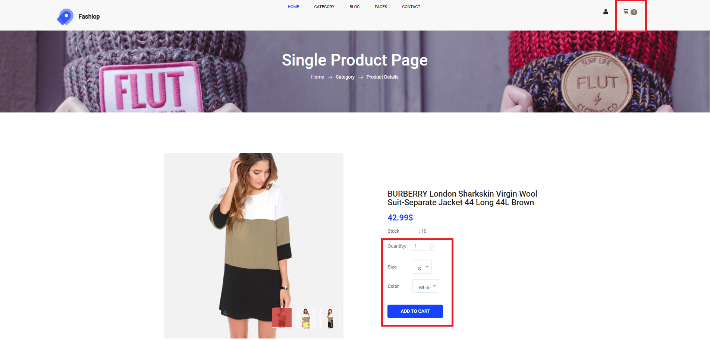
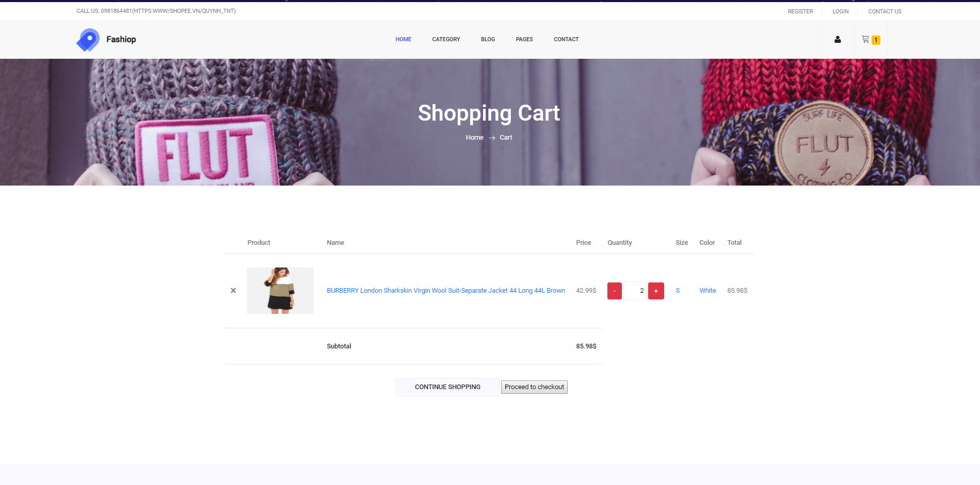
How do we do this?
Add to Cart

Slide 18
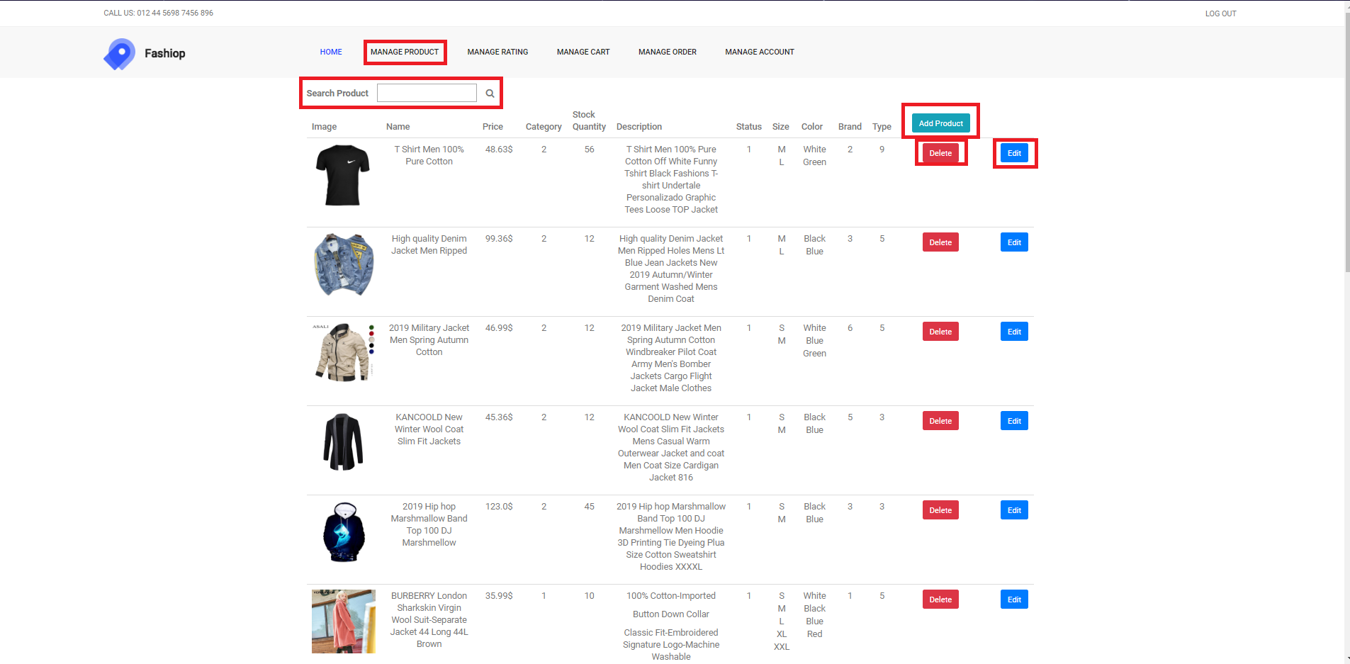
How do we do this?
Manage Product

Slide 19
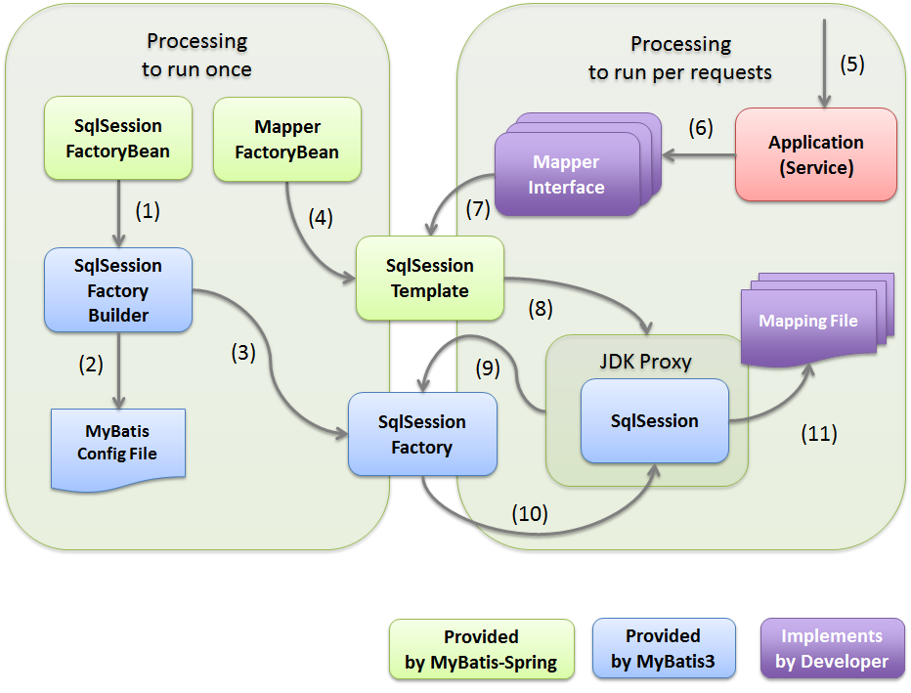
How do we do this?
Son Quach
Register member , customer
Checkuser name when user login.
Check data form signup.
Checkout insert order and orderdetail in database.
Manager Member(add, delete, insert).
Manager Customer(add, delete, insert).

Slide 20
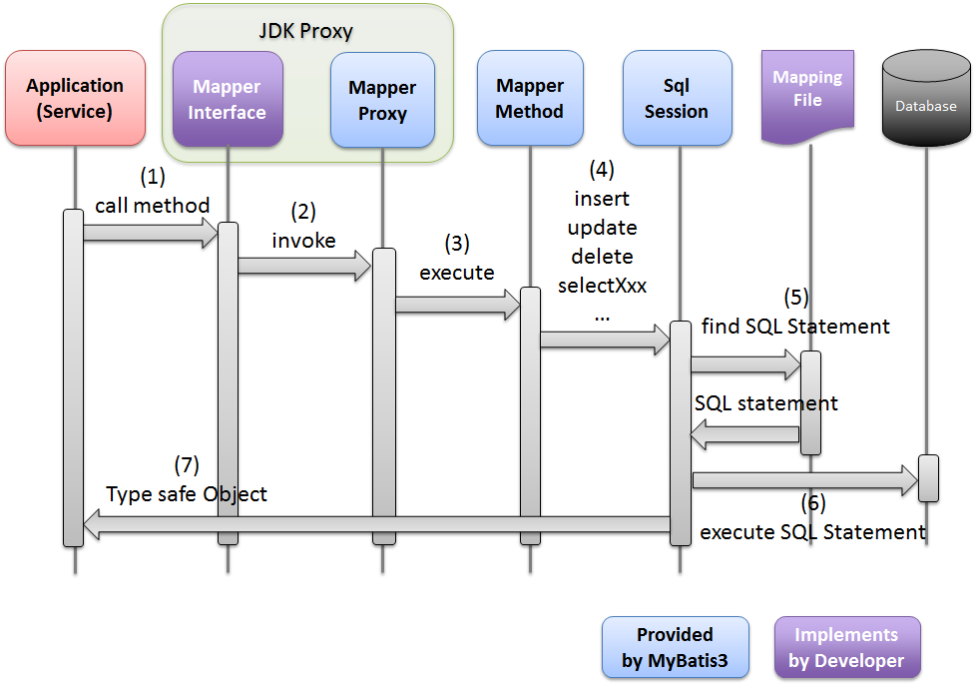
Spring MVC 3 Controller for MyBatis CRUD operation
Manager Member(add, delete, insert).
Manager Customer(add, delete, insert).

Slide 21
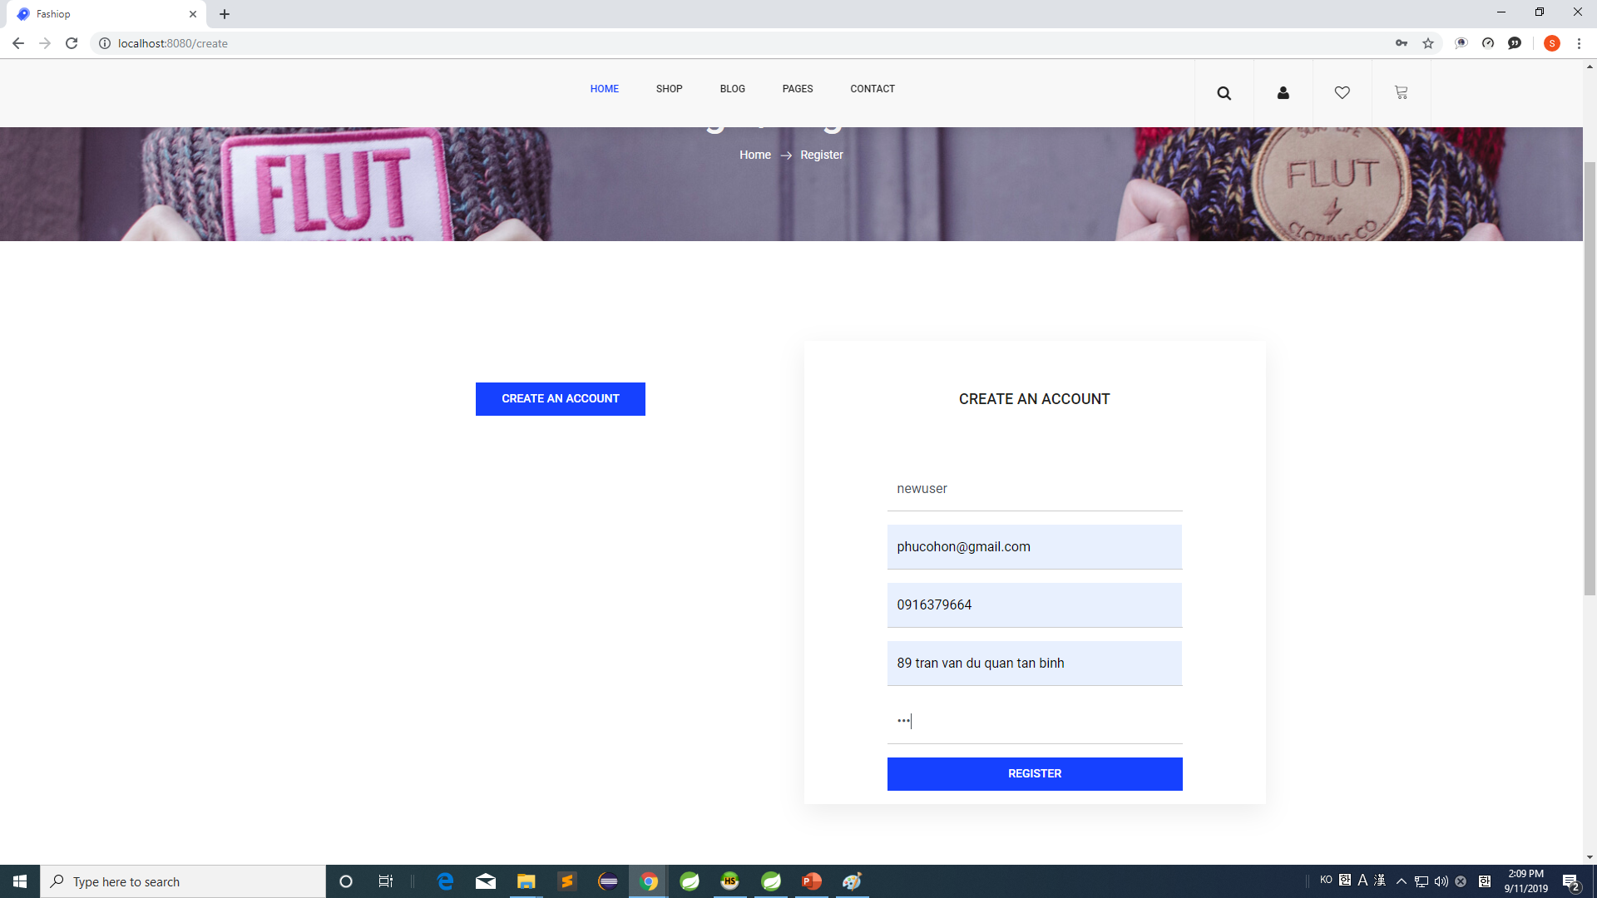
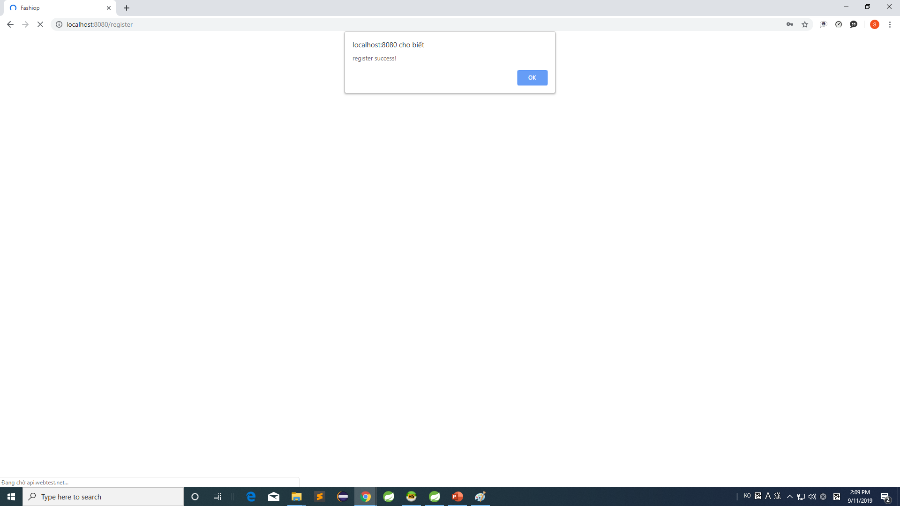
Signup new user

Slide 22
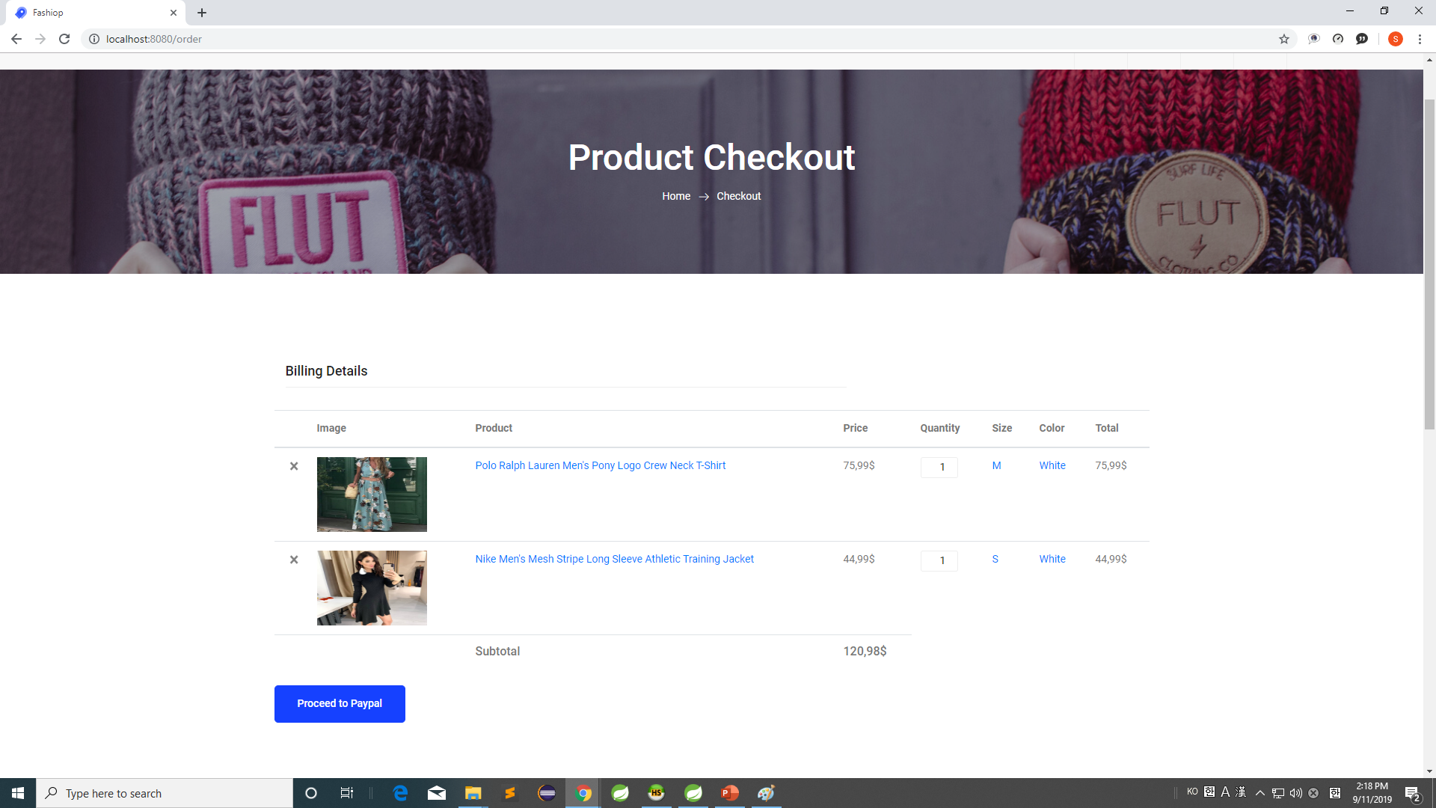
Checkout

Slide 23
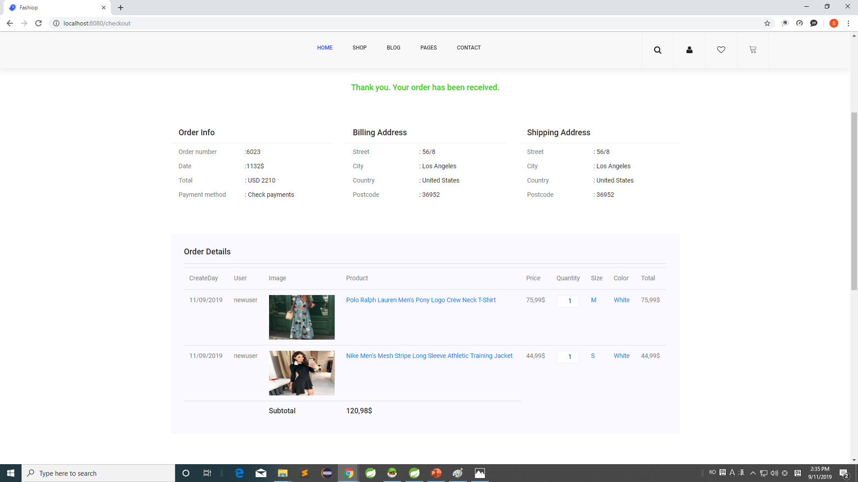
Checkout

Slide 24
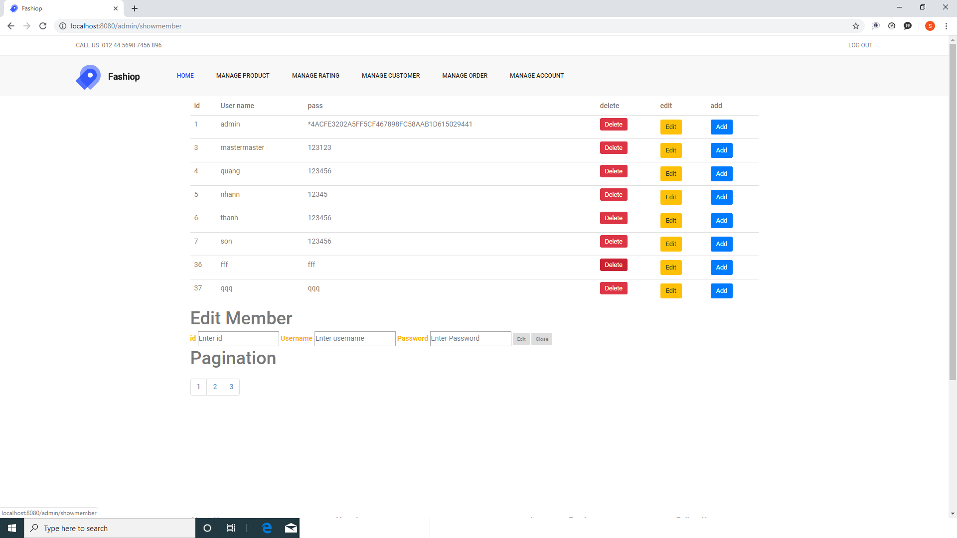
Manager Member (delete, edit, add)

Slide 25
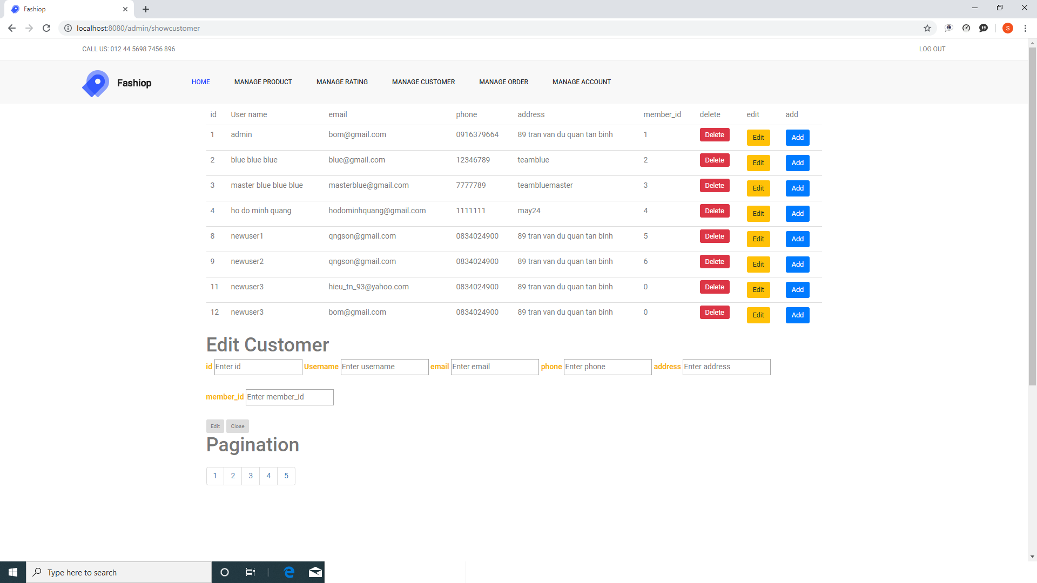
Manager Customer (delete, edit, add)

Slide 26
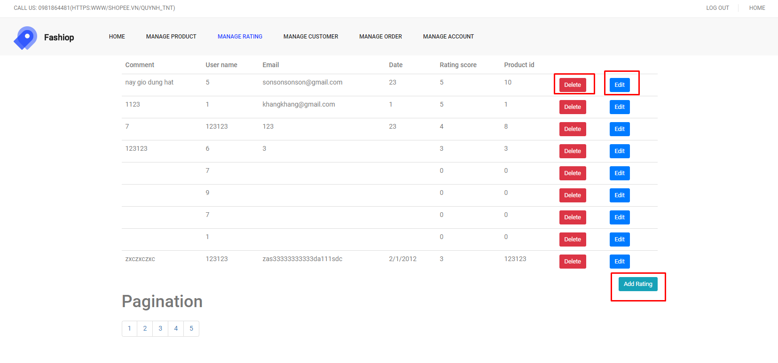
Manager Rating (delete, edit, add)

Slide 27
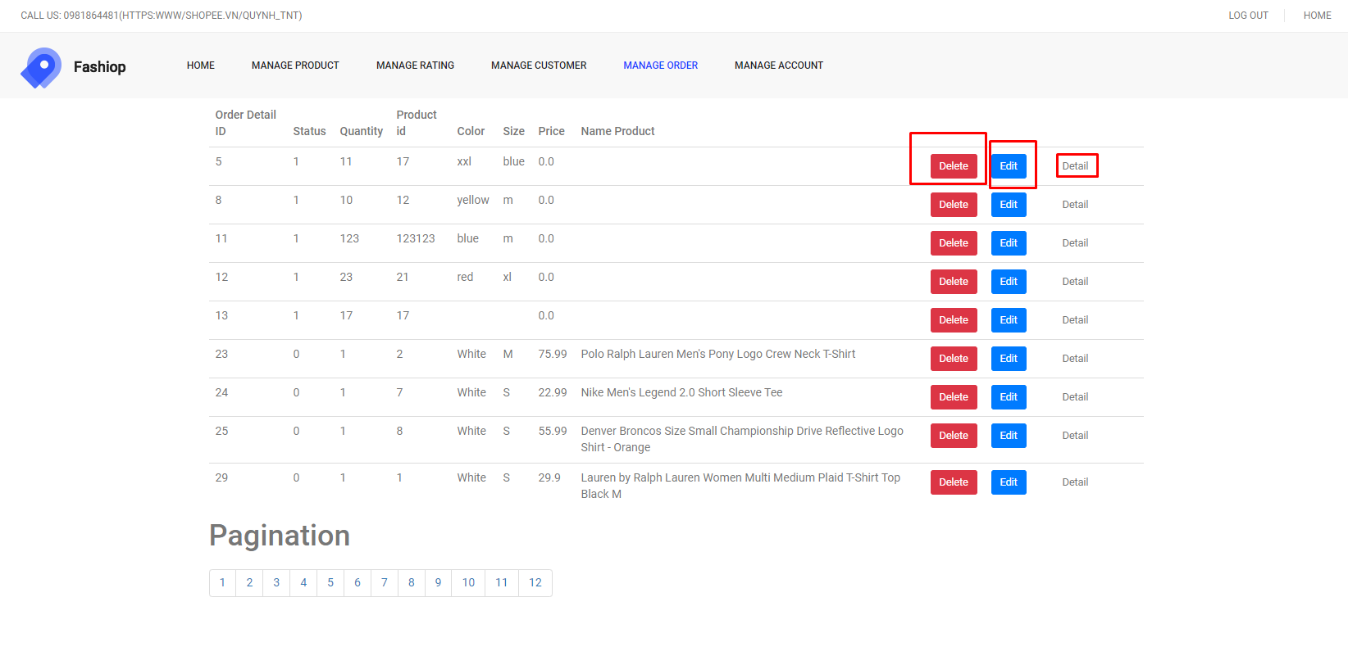
Manager ORDER (delete, edit, add)

Slide 28
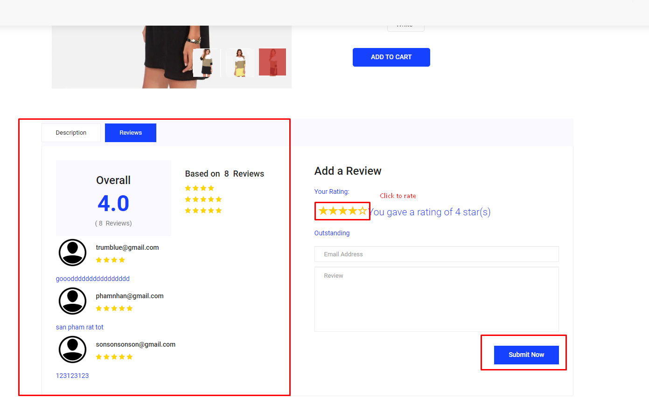
REVIEW

Slide 29
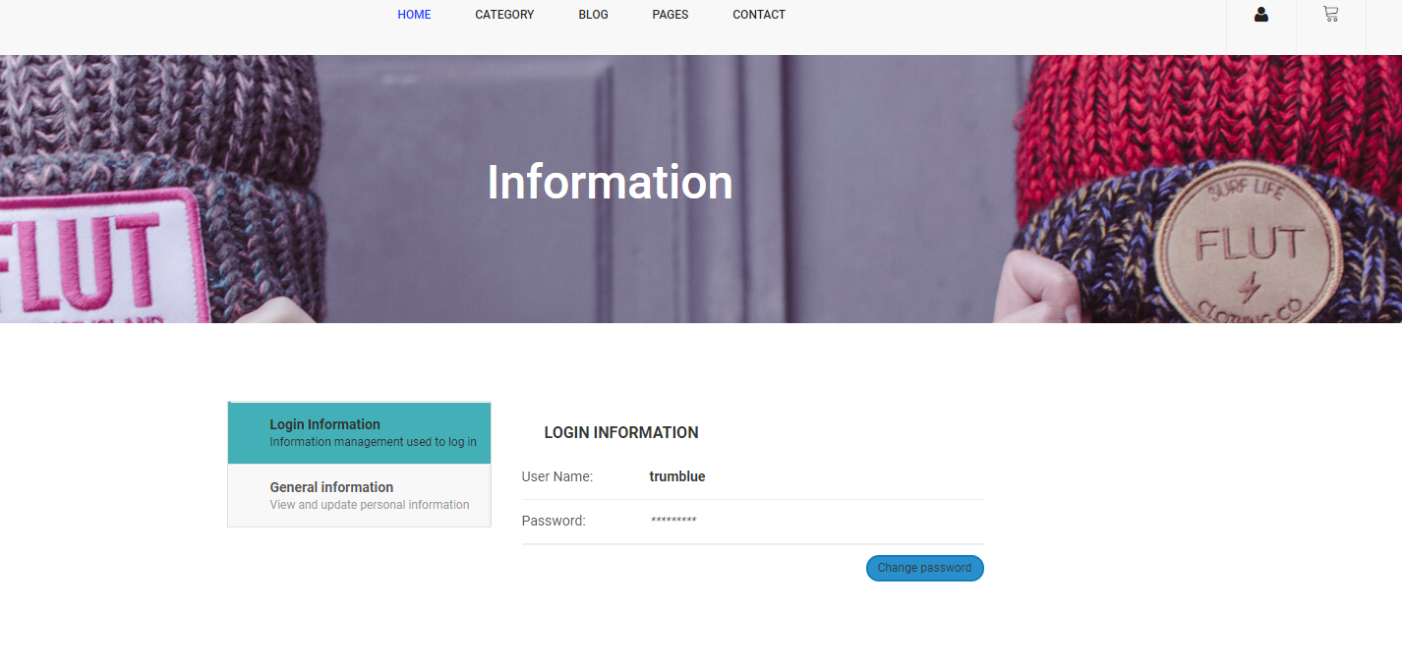
Information

